Slide 1
Brazil An. darlingi wings
Results and figures
10/15/2017

Slide 2
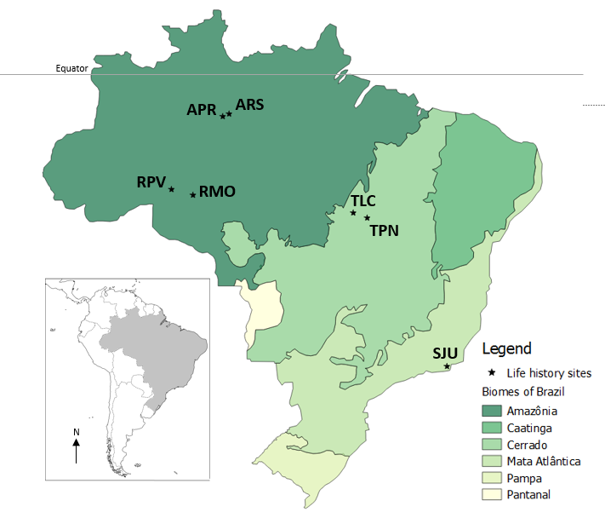
Map of field sites

Slide 3
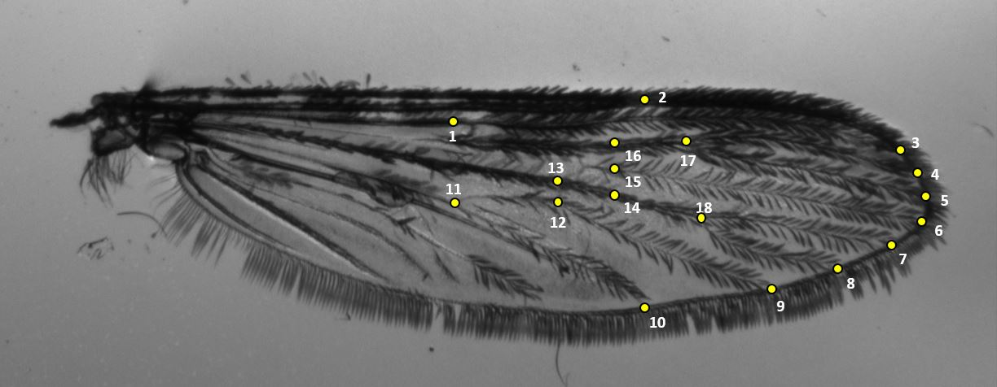
18 landmarks placement (Motoki 2012)

Slide 4
Preliminary data table
Biome | Locality | Latitude | Field (n) | Wing length (avg ± sd) | CS (avg± sd)
Amazon | ARS | -2.864 | 17 | 2.92 ± 0.2 | 2.7 ± 0.18
 | APR | -3.028 | 50 | 2.97 ± 0.18 | 2.75 ± 0.18
 | RPV | -8.742 | 47 | 2.95 ± 0.18 | 2.75 ± 0.16
 | RMO | -9.223 | 45 | 3.02 ± 1.8 | 2.83 ± 0.17
Cerrado | TLC | -10.7 | 54 | 3.09 ± 0.17 | 2.87 ± 0.15
 | TPN | -10.796 | 16 | 3.04 ± 0.17 | 2.89 ± 0.15
Mata Atlantica | SJU | -22.611 | 11 | 3.5 ± 0.1 | 3.26 ± 0.11

Slide 5
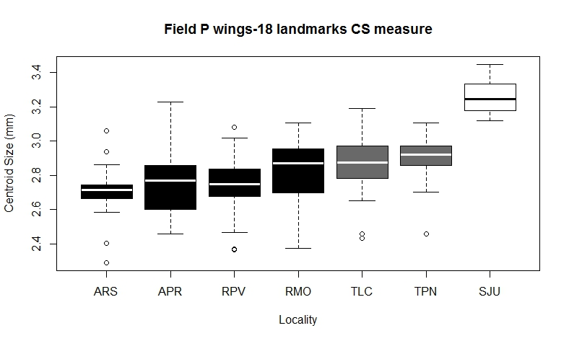
Centroid sizes by latitude
Legend
Amazon- Black
Cerrado- Gray
Mata Atlantica- White
Notes:
Done in R

Slide 6
Repeatability
Field samples- 240 total
Lab samples- 870 total
On 14.5% of data
Field (n=35) - 99.83%
Lab (n=126) -97.28%

Slide 7
Metric Disparity
Metric disparity results, 1000 bootstraps
 |  | FIELD 18 LANDMAKRS
Locality | n | MD | SE | CI left | ci right
ARS | 17 | 1.41E-03 | 0.000151 | 0.001124 | 0.001627
APR | 50 | 1.08E-03 | 7.43E-05 | 0.000966 | 0.001206
RPV | 47 | 1.37E-03 | 0.000216 | 0.001095 | 0.001787
RMO | 45 | 1.05E-03 | 7.28E-05 | 0.000912 | 0.001146
TLC | 54 | 1.17E-03 | 0.000153 | 0.000937 | 0.001433
TPN | 17 | 1.56E-03 | 0.0002 | 0.00121 | 0.001874
SJU | 11 | 7.39E-04 | 9.26E-05 | 0.000615 | 0.000931
Notes:
From CLIC

Slide 8
PAD discriminant analysis
PAD- Discriminant analysis
First | Correct | assignement
 | ARS | 12/17 | 70%
 | APR | 31/50 | 62%
 | RPV | 41/47 | 87%
 | RMO | 30/45 | 66%
 | TLC | 46/54 | 85%
 | TPN | 16/17 | 94%
 | SJU | 10/11 | 90%

Slide 9
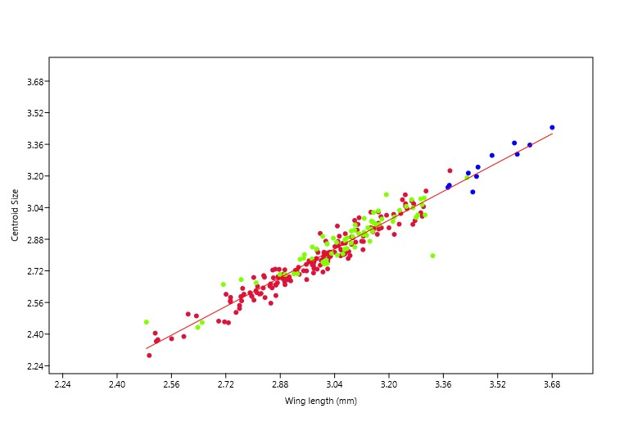
Wing length and CS regression
Legend
Amazon
Cerrado
Mata Atlantica
Confirms CS and wing length are highly correlated
Notes:
Done in PAST

Slide 10
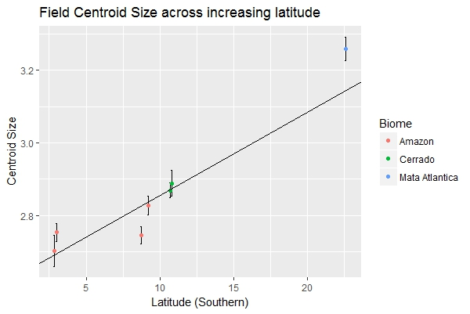
Centroid size over latitudes
Suggests support of a Bergmann cline
R^2=.2642, p<2.2e^-16
Notes:
Done in R

Slide 11
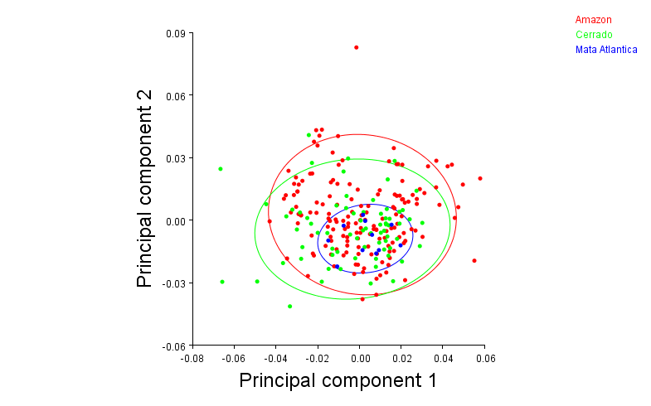
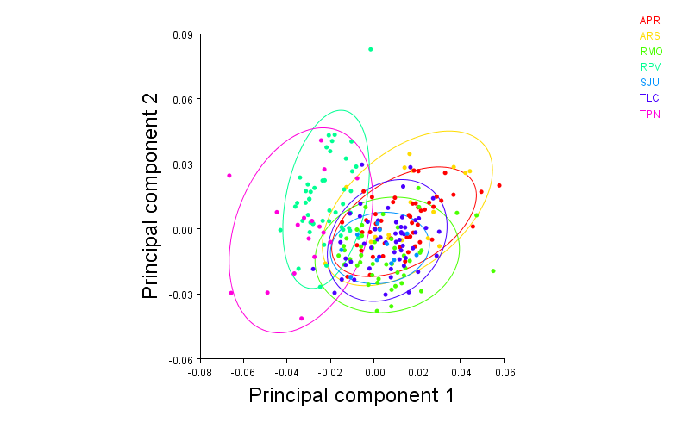
PCA’s by biome and latitude
PC1: 27.94%, PC2: 19.15%

Slide 12
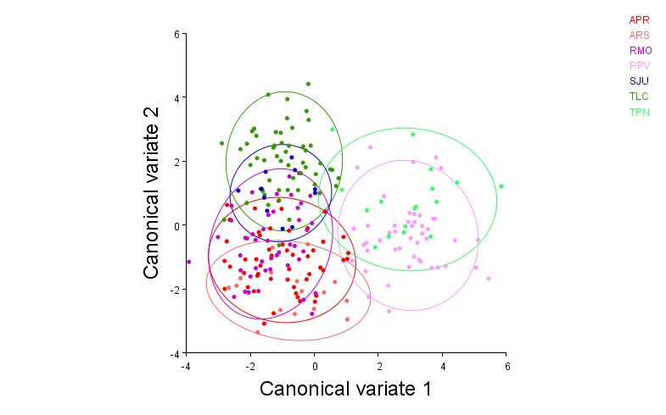
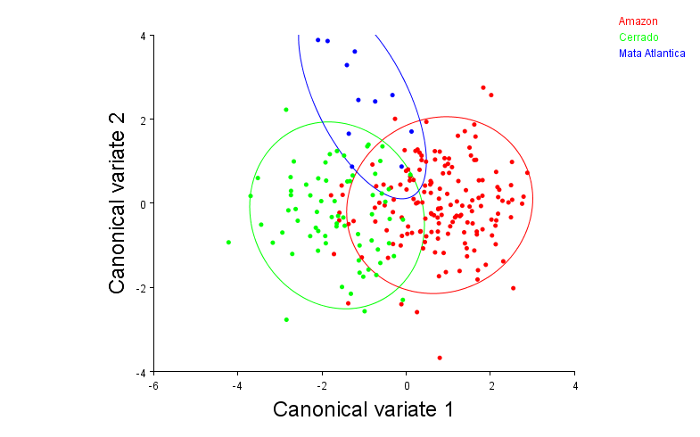
CVA by biome and latitude (10,000 permutations)
CV1: 53.69%, CV2: 27.66%
CV1: 80.71%, CV2: 19.29%

Slide 13
CVA by biome and latitude (10,000 permutations)
Bolded have p-values<0.001
Mahalanobis distances among groups:
 | APR | ARS | RMO | RPV | SJU | TLC
ARS | 1.7895
RMO | 1.8308 | 2.5093
RPV | 4.1091 | 4.4283 | 4.5022
SJU | 3.4508 | 4.1384 | 2.977 | 4.9272
TLC | 3.1466 | 4.2208 | 2.9916 | 4.5649 | 3.014
TPN | 4.8761 | 5.0438 | 4.8565 | 2.7394 | 4.8598 | 4.5795
Procrustes distances among groups:
 | APR | ARS | RMO | RPV | SJU | TLC
ARS | 0.0116
RMO | 0.0186 | 0.0241
RPV | 0.0384 | 0.0399 | 0.0393
SJU | 0.0258 | 0.0306 | 0.0203 | 0.0393
TLC | 0.0184 | 0.0264 | 0.0176 | 0.0361 | 0.0179
TPN | 0.0495 | 0.0515 | 0.0429 | 0.023 | 0.0401 | 0.0424
Mahalanobis distances among groups:
 | Amazon | Cerrado
Cerrado | 2.4605
Mata Atlantica | 3.1149 | 2.8236
Procrustes distances among groups:
 | Amazon | Cerrado
Cerrado | 0.0146
Mata Atlantica | 0.0227 | 0.0173

Slide 14
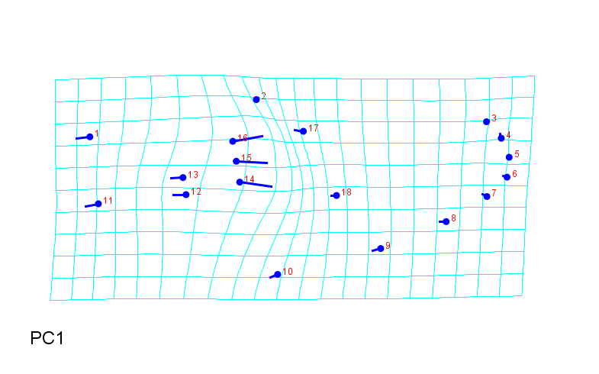
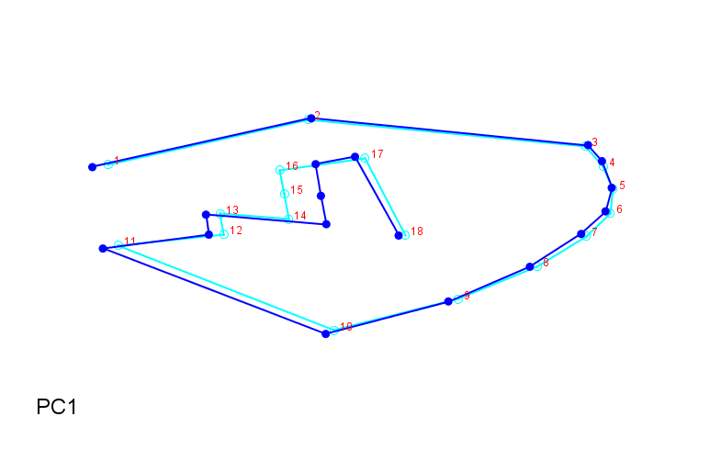
Field wing shape
Notes:
From PCA of all in Morphoj

Slide 15
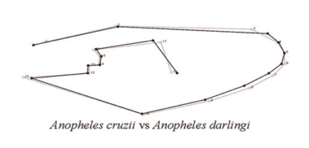
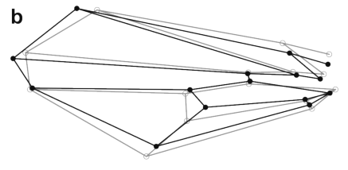
Wireframe question
Should I do this curve outline?
Or this with wing shape connections?
Wilke (2016)
Klingenberg (2013)

Slide 16

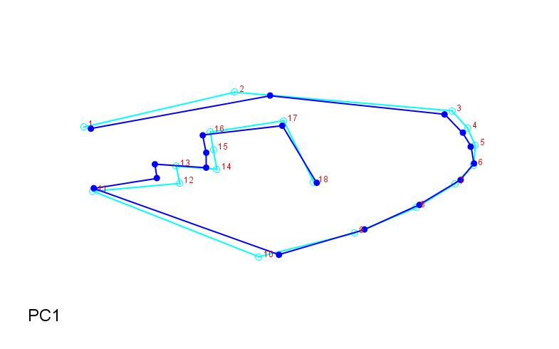
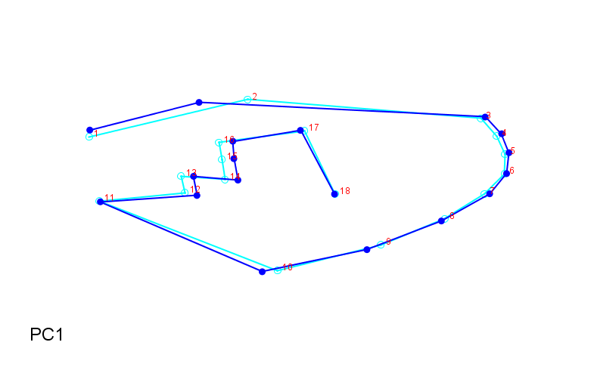
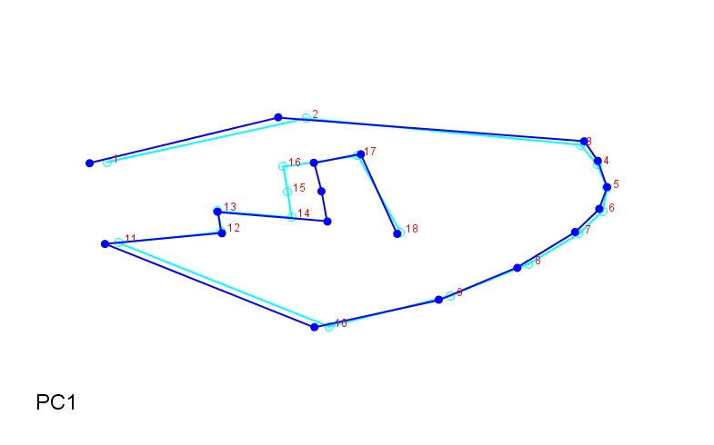
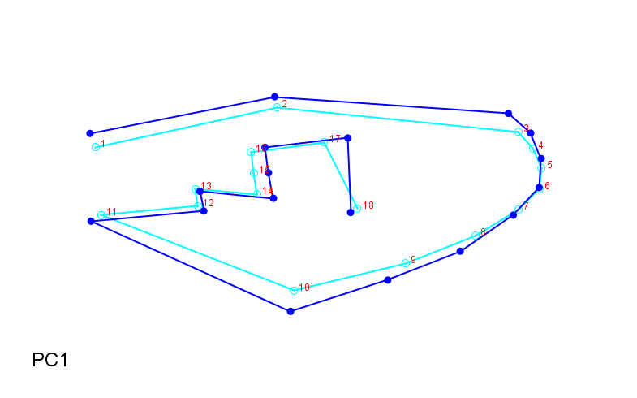
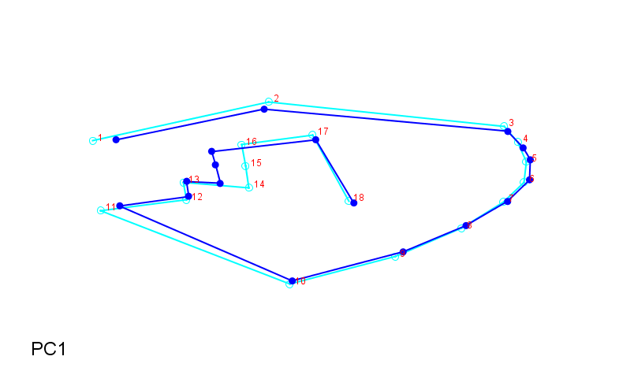
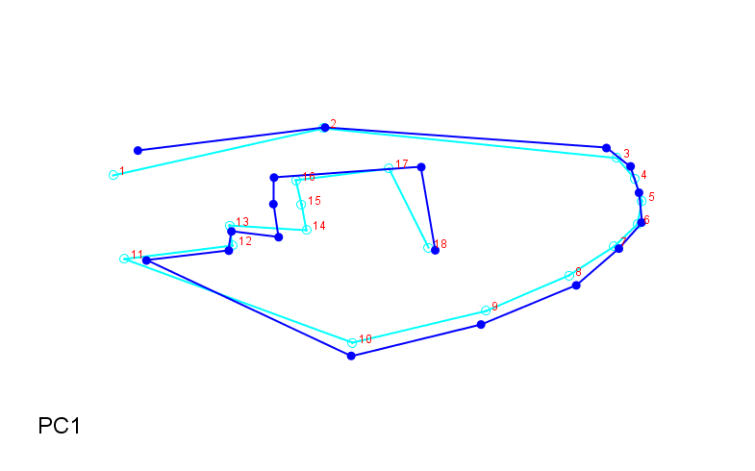
Field wing shapes by latitude
ARS
RPV
TPN
APR
RMO
TLC
SJU

Slide 17
Factorial Anova
model = lm(CS ~ Biome + Latitude + Biome:Latitude, data = fieldw)
> Anova(model, type="II")
Anova Table (Type II tests)
Response: CS
Sum Sq Df F value Pr(>F)
Biome 0.4600 2 8.8746 0.0001925 ***
Latitude 0.0940 1 3.6288 0.0580101 .
Biome:Latitude 0.0249 1 0.9612 0.3279049
Residuals 6.0907 235
---
Signif. codes: 0 ‘***’ 0.001 ‘**’ 0.01 ‘*’ 0.05 ‘.’ 0.1 ‘ ’ 1

Slide 18
MANOVA
fieldres.man<-manova(cbind(Length.mm, CS)~Locality, data=fieldw)
> summary(fieldres.man,test="Wilks")
Df Wilks approx F num Df den Df Pr(>F)
Locality 6 0.57775 12.204 12 464 < 2.2e-16 ***
Residuals 233
---
Signif. codes: 0 ‘***’ 0.001 ‘**’ 0.01 ‘*’ 0.05 ‘.’ 0.1 ‘ ’ 1
> summary.aov(fieldres.man)
Response Length.mm :
Df Sum Sq Mean Sq F value Pr(>F)
Locality 6 3.2791 0.54652 18.679 < 2.2e-16 ***
Residuals 233 6.8171 0.02926
---
Signif. codes: 0 ‘***’ 0.001 ‘**’ 0.01 ‘*’ 0.05 ‘.’ 0.1 ‘ ’ 1
Response CS :
Df Sum Sq Mean Sq F value Pr(>F)
Locality 6 3.1201 0.52002 20.465 < 2.2e-16 ***
Residuals 233 5.9207 0.02541
---
Signif. codes: 0 ‘***’ 0.001 ‘**’ 0.01 ‘*’ 0.05 ‘.’ 0.1 ‘ ’ 1
fieldres.man1<-manova(cbind(Length.mm, CS)~Biome, data=fieldw)
> summary(fieldres.man1,test="Wilks")
Df Wilks approx F num Df den Df Pr(>F)
Biome 2 0.67752 25.358 4 472 < 2.2e-16 ***
Residuals 237
---
Signif. codes: 0 ‘***’ 0.001 ‘**’ 0.01 ‘*’ 0.05 ‘.’ 0.1 ‘ ’ 1
> summary.aov(fieldres.man1)
Response Length.mm :
Df Sum Sq Mean Sq F value Pr(>F)
Biome 2 3.1139 1.55697 52.848 < 2.2e-16 ***
Residuals 237 6.9823 0.02946
---
Signif. codes: 0 ‘***’ 0.001 ‘**’ 0.01 ‘*’ 0.05 ‘.’ 0.1 ‘ ’ 1
Response CS :
Df Sum Sq Mean Sq F value Pr(>F)
Biome 2 2.8312 1.4156 54.028 < 2.2e-16 ***
Residuals 237 6.2096 0.0262
---
Signif. codes: 0 ‘***’ 0.001 ‘**’ 0.01 ‘*’ 0.05 ‘.’ 0.1 ‘ ’ 1

